Slide 1
Quadratic Classifiers (QC)
J.-S. Roger Jang (張智星)
jang@mirlab.org
http://mirlab.org/jang
MIR Lab, CSIE Dept.
National Taiwan University

Slide 2
Review: PDF Modeling
Goal:
Find a PDF (probability density function) that can best describe a given dataset
Steps:
Select a class of parameterized PDF
Identify the parameters via MLE (maximum likelihood estimate) based on a given set of sample data
Commonly used PDFs:
Multi-dimensional Gaussian PDF
Gaussian mixture models (GMM)

Slide 3
PDF Modeling for Classification
Procedure for classification based on PDF
Training stage: PDF modeling of each class based on the training dataset
Test stage: For each entry in the test dataset, pick the class with the max. PDF
Commonly used classifiers:
Quadratic classifiers, with n-dim. Gaussian PDF
Gaussian-mixture-model classifier, with GMM PDF

Slide 4
1D Gaussian PDF Modeling
1D Gaussian PDF:
MLE of μ (mean) and σ² (variance)

Slide 5
D-dim. Gaussian PDF Modeling
D-dim Gaussian PDF:
MLE of μ (mean) and Σ (covariance matrix)

Slide 6
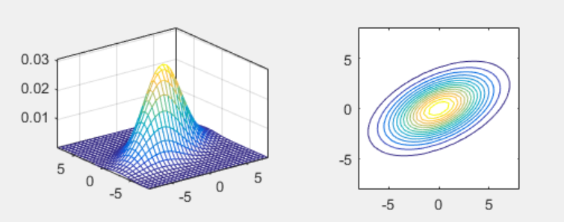
2D Gaussian PDF
Bivariate normal distribution:
PDF
Contours

Slide 7
Training and Test Stages of QC
Quiz!
Training stage
Identify the Gaussian PDF of each class via MLE
Test stage
Assign a sample point to the class C by taking class prior into consideration:

Slide 8
Characteristics of QC
If each class is modeled by an Gaussian PDF, the decision boundary between any two classes is a quadratic function.
That is why it is called quadratic classifier.
How to prove it?
Quiz!

Slide 9
QC on Gender Dataset (1/2)
Scatter plot of Gender dataset

Slide 10
QC on Gender Dataset (2/2)
PDF for each class
Decision boundary

Slide 11
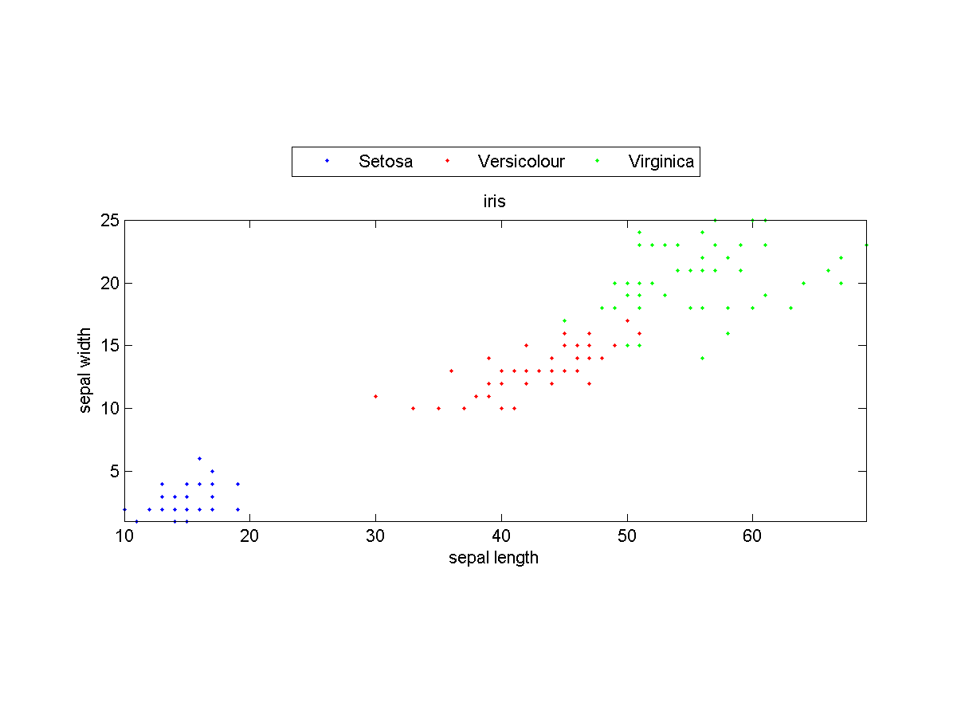
QC on Iris Dataset (1/3)
Scatter plot of Iris dataset (with only the last two dim.)

Slide 12
QC on Iris Dataset (2/3)
PDF for each class:

Slide 13
QC on Iris Dataset (3/3)
Decision boundaries among classes:

Slide 14
Strength and Weakness of QC
Quiz!
Strength
Easy computation when the dimension d is small
Efficient way to compute leave-one-out cross validation
Weakness
The covariance matrix (d by d) is big when the dimension d is median large
The inverse of the covariance matrix may not exist
Cannot handle bi-modal data correctly

Slide 15
Modified Versions of QC
Quiz!
How to modify QC such that it won’t deal with a big covariance matrix?
Make the covariance matrix diagonal ➔ Equivalent to naïve Bayes classifiers (proof?)
Make the covariance matrix a constant times an identity matrix

